Slide 1
Design and implementation virtual reality for toga plants

Slide 2


Fifi Maghfirotun Nisa’
Politeknik Elektronika Negeri Surabaya
Game Technology
(4210171030)
Advisors:
Artiarini Kusuma Nurindiyani, S.ST., MT 198806052019032018
Fardani Annisa Damastuti, S.ST., MT 198310072015042001
Prof. Dr. Achmad Fuad Hafid, Apt. MS 195212121981021009

Slide 3
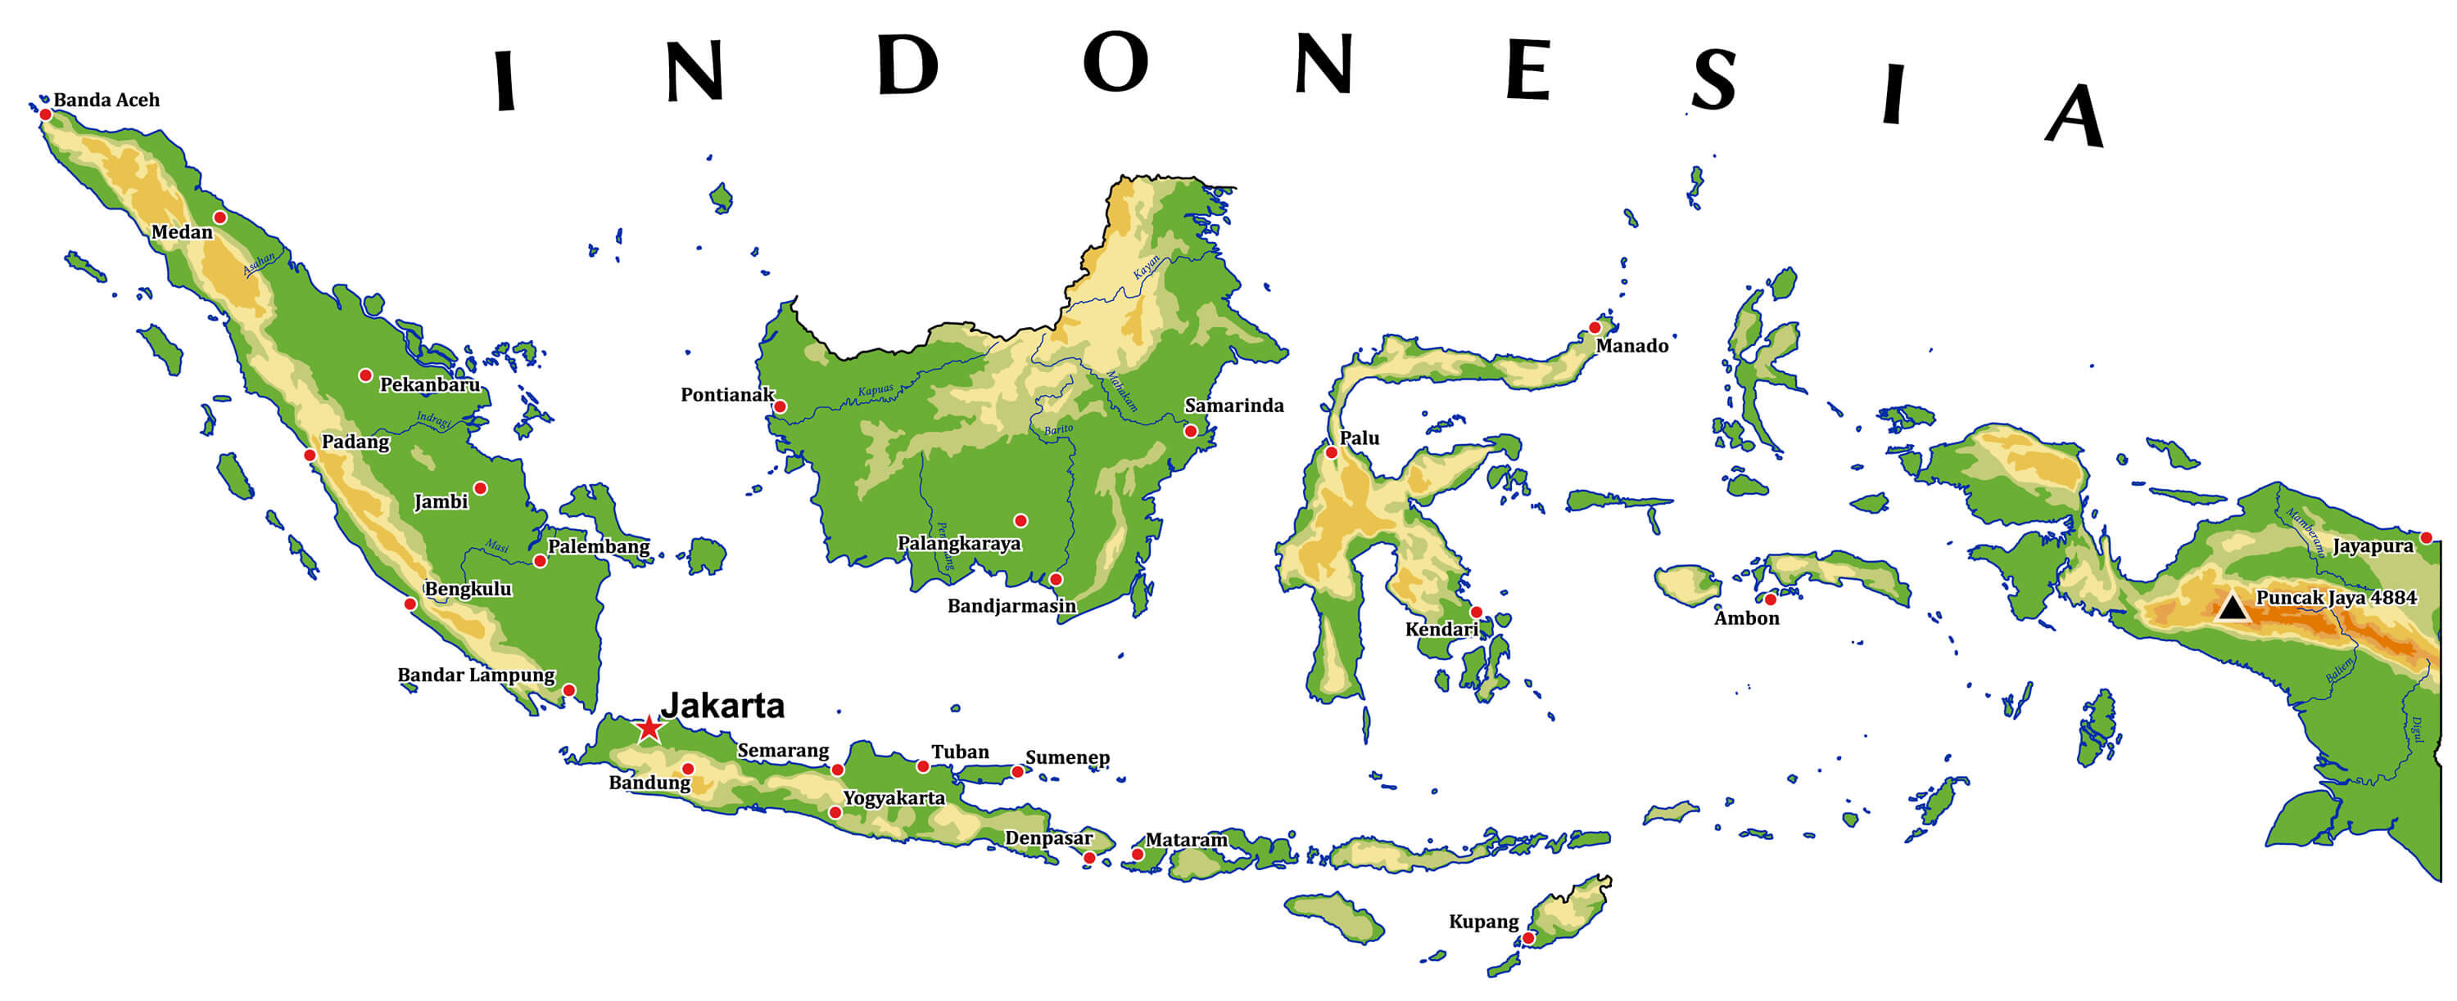
Background
Indonesia has so many kind of plants across the country,
especially in herbs plants

Slide 4
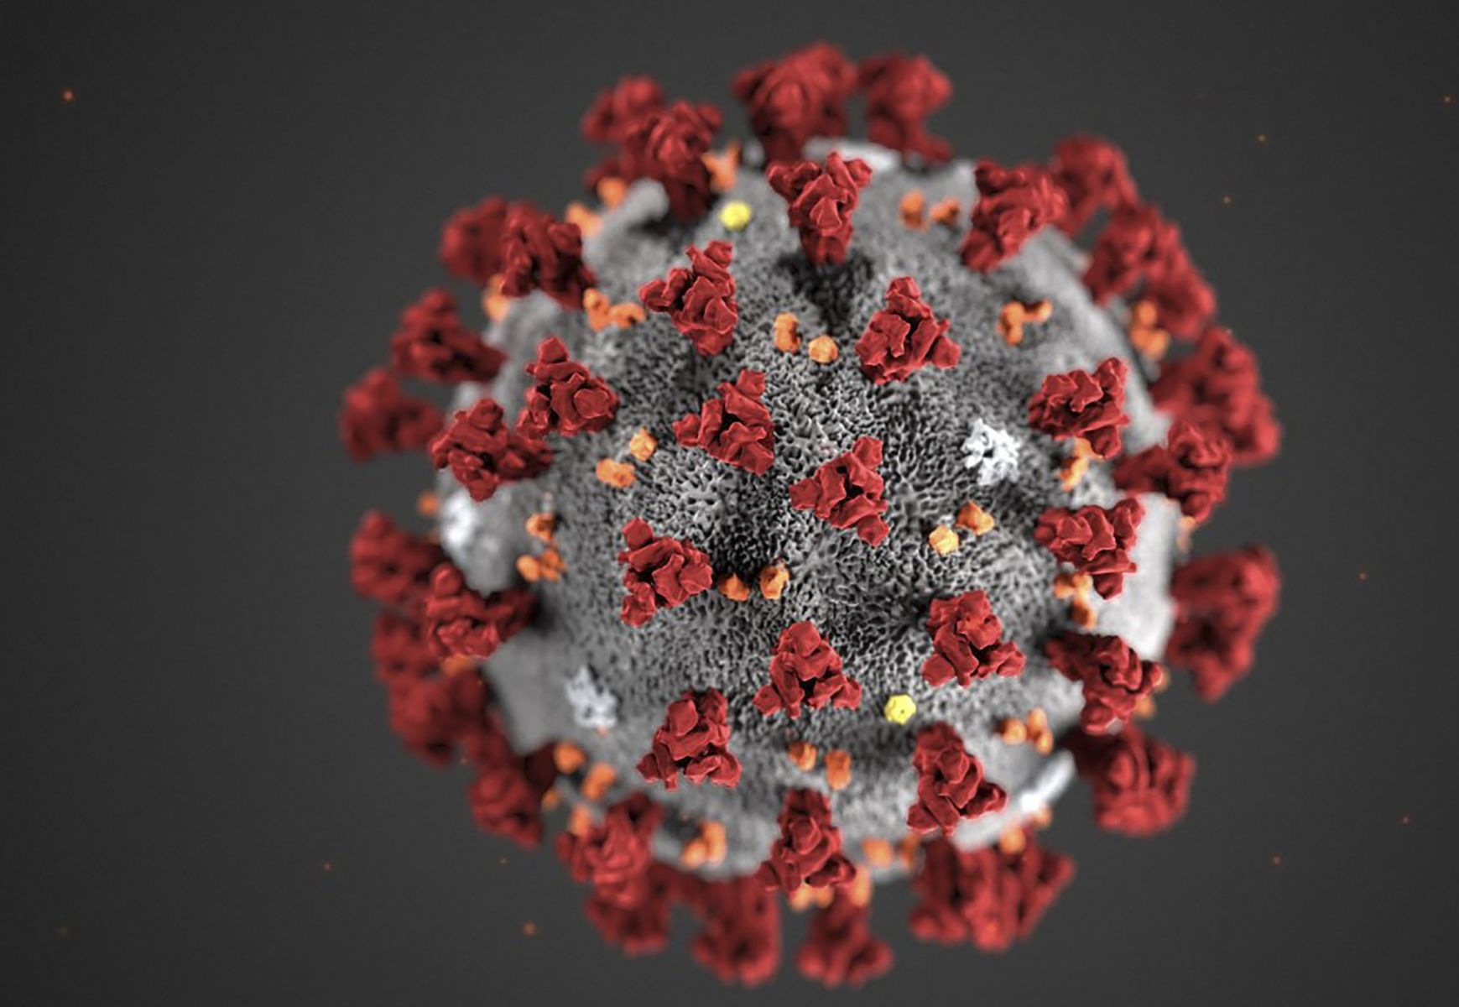
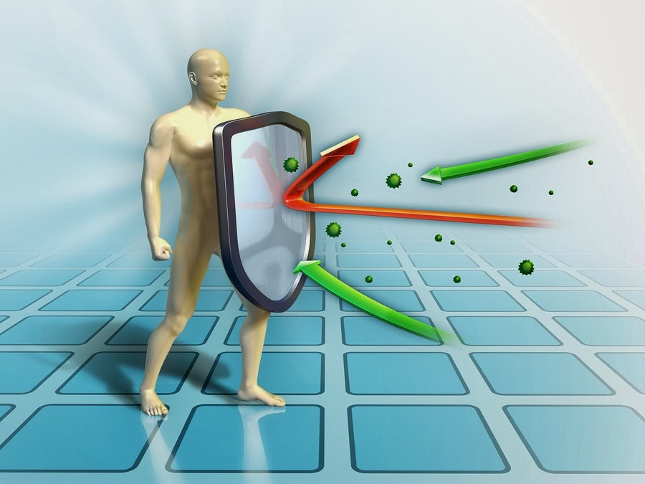

During this pandemic, people are aware of their health and want
to enhance immunity

Slide 5
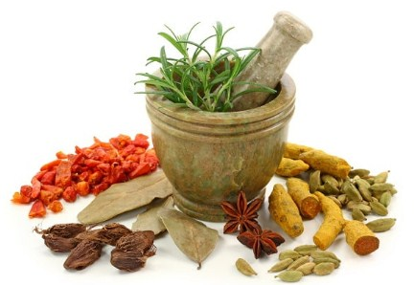

TOGA Plants is one of the best Choice
Do people know about the advantages and best recipe to make it ?

Slide 6
Problem
An Innovative solutions to introduce TOGA Plants especially for the now young generations

Slide 7
Objective
Increase knowledge about TOGA Plants
Implements TOGA Plants in a multimedia application
Make an interesting educational facilities for TOGA Plants

Slide 8
Scope of Problem
Making introduction media about TOGA Plants and its benefits
The media is virtual reality games using the oculus rift device
The selected TOGA Plants that useful in increasing immunity
Game for making herbs drinks to enhance immunity

Slide 9
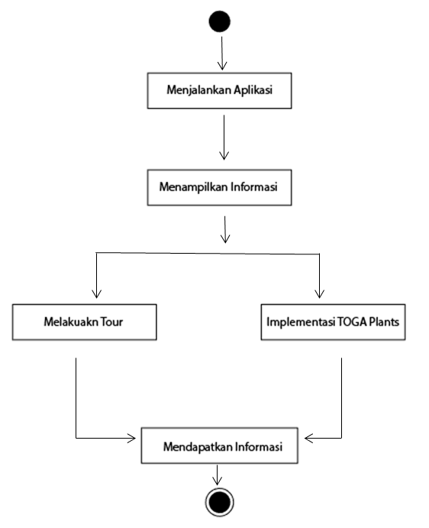
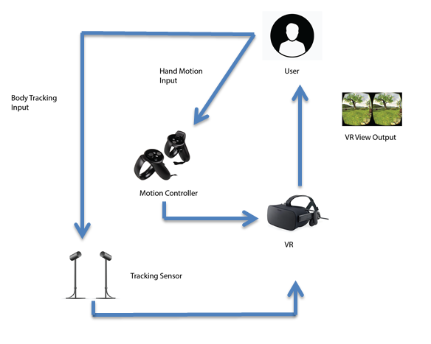
Diagram System

Slide 10
Research Method (MLDC)
Problems
Planning and Design
Evaluation
Execution

Slide 11
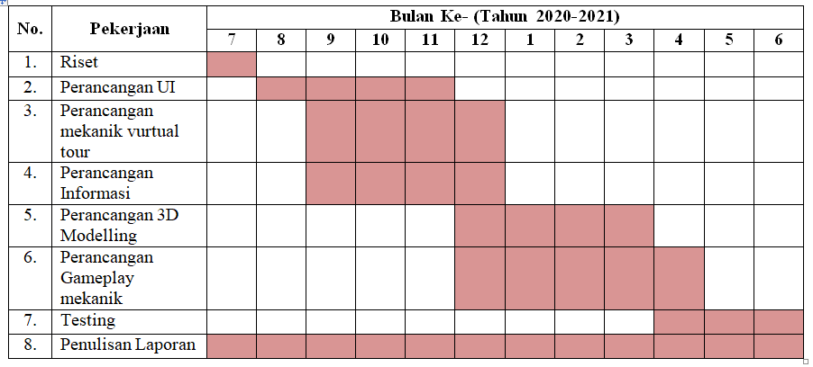
Timeline

Slide 12
Target Implementation
Educational media about TOGA plants and its benefits

Slide 13
THANK You

